Slide 1
High Frequency Active Auroral Research
Presented to Prof. Humayun Adil

Slide 2
Presented by Group#3
M. Muzammil Ejaz (BSEF12M054)
Saifullah Tariq (BSEF12M049)
Badar Iqbal (BSEF12M038)
Raza Ahmad (BSEF12M061)
Hassan Anwar (BSEF12M014)
Kamal Ahmed (BSEF12M060)
Hisham Zahid (BSEF12M025)

Slide 3
Introduction
Ionosphere research program
HAARP Station began in 1990
Designed and built by BAE Advanced Technologies (BAEAT)
Funded by:-
  U.S. Air Force
  U.S. Navy
  University of Alaska
  Defense Advanced Research Projects Agency (DARPA)

Slide 4
Purpose
Analyze the ionosphere
Radio communications
  Mainly military
Surveillance system
Meteor warnings
Minimizing satellite usage
  Avoid solar flare interruptions

Slide 5
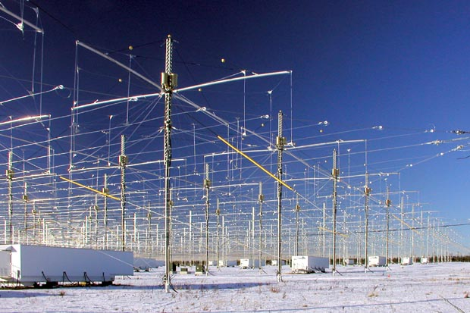
Research
Study of the uppermost portion of the atmosphere (Ionosphere)
Ionosphere Research Instrument (IRI)
  high-power radio frequency transmitter

Slide 6
Ionosphere
Region of the upper atmosphere, from about 85 km (53 mi) to 600 km (370 mi) altitude
Important in atmospheric electricity and forms the inner edge of the magnetosphere
Influences radio propagation to distant places on the Earth

Slide 7
Some Research Aspects
Stimulated electron emission observations
High frequency heating research
Radio observations of Meteor shower impacts on the ionosphere
Response/Recovery of the ionosphere from solar flares and geomagnetic storms
Effect of ionosphere disturbances on GPS

Slide 8
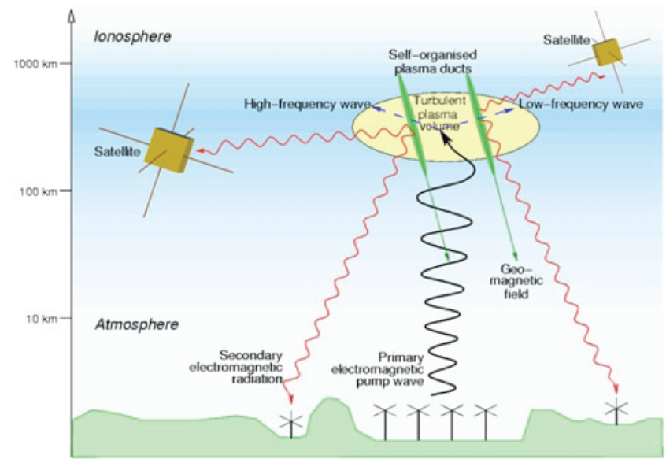
HAARP + Ionosphere

Slide 9
Main Scientific Findings
Generating very low frequency radio waves
Generating weak luminous glow
Generating extremely low frequency waves
Perfection in military communications with submarines and underground bunkers

Slide 10
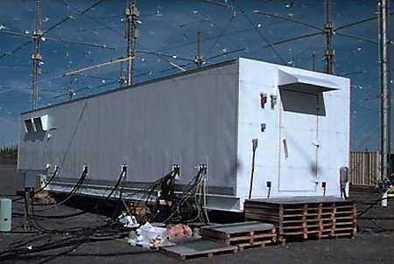
Instrumentation and operation
Ionosphere Research Instrument (IRI)
    high power, high-frequency phased array radio transmitter
    180 antennas
    array of 12x15 units
    33 acres (13 hectares)
    rectangle
    It energize a small portion
    of the ionosphere

Slide 11
Instrumentation and operation
Geophysical instruments
  Magnetometer
  Induction magnetometer
  Set of five 2500 kilowatt generators

Slide 12
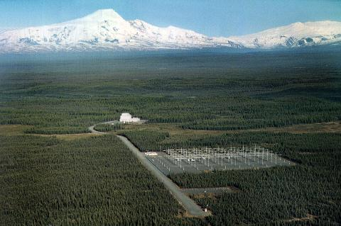
Site
Site is (62°23′30″N 145°09′03″W)
North of Gakona, Alaska

Slide 13
Construction phases
Developmental Prototype had 18 antenna(1993)
  It was fed 360 kilowatts
Filled Developmental Prototype had 48 antenna units
  with 960 kW of transmitter power
Final IRI (FIRI) has 180 antenna units (2007)
  3.6 MW of transmitter power

Slide 14
Related facilities
Sura Ionosphere Heating Facility (Novgorod Russia)
European Incoherent Scatter Scientific Association (EISCAT)
  Ionosphere heating facility
HIPAS in Fairbanks, Alaska
  dismantled in 2009

Slide 15
The HAARP controversies
HAARP is a target of following conspiracy theories:
Disrupt human mental processes.
Jam all global communications systems.
Change weather patterns over large areas.
Interfere with wildlife migration patterns.
Negatively affect your health.

Slide 16
The HAARP controversies
Unnaturally impact the Earth's upper atmosphere.
Other blames:
  Erupting volcanoes
  Earthquakes
  Droughts
  Storms
  Floods
  Diseases
    Gulf War Syndrome
    Chronic Fatigue Syndrome

Slide 17
Weather Modification
HAARP has the ability to control weather by altering upper atmosphere wind patterns.
It is done by focusing high frequency radio transmissions on the ionosphere.

Slide 18
Eco-type of terrorism
Ability to alter the climate, set off earthquakes, volcanoes remotely through the use of electromagnetic waves.
The following statement was made in a documentary titled Weather Warfare which was put together by the History Channel:
“Directed energy is such a powerful technology it could be used to heat the ionosphere and turn weather into a weapon of war.”

Slide 19
Misinformed Theories
All conspiracy theories are misinformed because it is mysterious (Computer scientist David Naiditch)
“HAARP radiation is minuscule compared with the power of a lightning flash, so we can’t affect weather” (Stanford University professor Umran Inan )
Conspiracy theories often overshadows the benefits HAARP (Journalist Sharon )

Slide 20
In popular culture
HAARP has been dramatized by
  Marvel Comics
  The X-Files (TV-series)
  X-Men Legends game
  Episode of Conspiracy Theory with Jesse Ventura
  Remo Williams: The Adventure Begins. (1985 film)
  This lead to misinformed theories.

Slide 21
Shutdown
In early May 2013
change between contractors
(DARPA) is expected to finish up some research
The Alaska Native Corporation Athena, Incorporated is reportedly in talks to take over the facility

Slide 22
Overview
IRI directs a 3.6 MW signal into ionosphere to:
Studies effects of the transmission and recovery period
Advance the study of basic natural processes (not causing them)
  Weather changes
  Solar flares protection
  Earthquakes, Storms etc

Slide 23
Overview
Improve communication and navigation systems
GPS navigation
Advances in underwater and underground research and applications
  For submarine communication
  Remotely sense and map the mineral

Slide 24
Overview
Project struggles for openness and legality
HAARP facility regularly hosts open houses
Scientific results routinely published
Summer school for visiting students

